Slide 1


Eric Layer
January 5th, 2022

Slide 2

Outline
Executive Summary
Introduction
Methodology
Results
Conclusion
Appendix

Slide 3

EXECUTIVE SUMMARY
Methodologies:
Scraped SpaceX data from the Web using Python.
Performed Data Wrangling on the data to filter for necessary elements:
Falcon9 Rockets and Falcon Heavy Launches.
Proceeded with EDA using Python, SQL.
Made plotly dashboards in addition (using Python) along with folium.
Utilized select Machine Learning Algorithms.

Slide 4
EXECUTIVE SUMMARY
Results:
Falcon9 rocket successes sometimes differed by booster version and payload mass.
Rate of mission/launch success grew over time, in general.
The CCAFS SLC-40 site had the highest rate of success.
Most successful launches came within about 2k-6k payload mass, no correlation to deduce optimal mass, however.
Machine Learning Algorithms used predicted whether launch was a success with around 83% accuracy.
All algorithms returned identical confusion matrices.

Slide 5

INTRODUCTION
Our SpaceY company wishes to pursue space exploration.
Thus, our project aims to find what specs and parameters yield the most successful rocket launches for SpaceX tests.
Therefore, we want to analyze launch data from SpaceX to deduce the optimal metrics for us to discover in order to optimize our rockets.

Slide 6


Slide 7

METHODOLOGY
Scrape SpaceX data using Python from Wikipedia.
Filter the tables scraped for data of interest (using requests and Beautiful Soup). Namely predictive parameters of each launch and whether it had a successful outcome. Created data frame from the parsed launch data.
Perform EDA on the data using Python and SQL.
Build dashboards to illustrate the success rate of rocket launches of each launch site based on predictive parameters.
Run Machine Learning algorithms on the SpaceX data to derive what optimal parameters for a successful launch are.
Logistic Regression, Decision Tree, Support Vector Machine, and K-Nearest Neighbor algorithms used.

Slide 8
Methodology
Executive Summary
Data collection methodology:
Data collected using Python libraries requests and Beautiful Soup.
Perform data wrangling:
Filter for predictive parameters useful in predicting launch success using numpy and pandas in Python.
Perform exploratory data analysis (EDA) using visualization in Python and SQL.
Perform interactive visual analytics using Folium and Plotly Dash.
Perform predictive analysis using classification models:
Using numeric and categorical predictive parameters, we will utilize them to predict a binary classifier for whether a launch was successful or not. We used train_test_split for model building and evaluation and utilized 4 Machine Learning Algorithms:
K-Nearest Neighbor, Decision Tree, Support Vector Machine, Logistic Regression

Slide 9
Data Collection
In detail, we use Requests and Beautiful Soup from Python to scrape the SpaceX data from the SpaceX API. We collected data upon many parameters, such as data on rockets, launch sites, payloads, and cores.
From the data in these requests, we created a data frame to house the data used in our visualizations and predictive modeling. The data we take is information regarding the launches of the rockets.
We also filter out data frame to include only Falcon9 rocket launches and then use column means to replace NaN values with respective columns in our data.
Following this we extract Falcon9 launch data from Wikipedia and extract the data germane to our project from the page’s tables (using Requests and Soup).

Slide 10
Data Collection Overview - Flowchart
SpaceX Data
Requests, Beautiful Soup
SpaceX Data
Numpy & Pandas for Falcon9 data
SpaceX Data
Preprocessing with Numpy & Pandas
SpaceX API
SpaceX_API_csv
Export
SpaceX Data
Requests, Beautiful Soup
SpaceX Data
Create data frame from HTML tables with Pandas
Wikipedia SpaceX Data Tables
SpaceX_Wiki_csv
Export

Slide 11
Data Collection – SpaceX API
Define functions to get distinct data for columns
Data collection (with SpaceX REST calls) flowchart overview:
Link to Github Page: https://github.com/elayer/SpaceXProject/blob/master/SpaceX%20Project.ipynb
def getBoosterVersion(data): for x in data['rocket']: response = requests.get("https://api.spacexdata.com/v4/rockets/"+
(x)).json() BoosterVersion.append(response['name'])
Use requests to pull data from the SpaceX API
response = requests.get(spacex_url)
Normalize the json response object from pandas
data = pd.json_normalize(response.json())
Call functions to corresponding column data
getBoosterVersion(data)
Filter for launches that are Falcon9
data_falcon9 = launch_df[launch_df['BoosterVersion'] != 'Falcon 1']
Replacing columns with missing data with means
data_falcon9['PayloadMass'].replace(np.nan, payloadMean)
Exporting as a csv for later use
data_falcon9.to_csv('dataset_part_1.csv', index=False)

Slide 12
Data Collection - Scraping
Define helper functions to get distinct data for columns
Overview of SpaceX web scraping on the right:
Link to GitHub Page:
https://github.com/elayer/SpaceXProject/blob/master/SpaceX%20Data%20Wrangling.ipynb
def booster_version(table_cells): out=''.join([booster_version for i,booster_version in
( table_cells.strings) if i%2==0][0:-1]) return out
Retrieve the data using requests
resp = requests.get(static_url)
Create a Soup project from the text from requests object
soup = BeautifulSoup(resp.text)
Use find_all method to extract table elements from HTML
html_tables = soup.find_all('table')
Initialize the launch_dict to get data in dictionary form to later contort into a data frame. Then put according data into values of the dictionary.
launch_dict=
.fromkeys(column_names)
Export the resulting data frame to a CSV file
df.to_csv('spacex_web_scraped.csv', index=False)

Slide 13
Data Wrangling
Replaced NaNs with column means done in previous notebook.
We then calculated the number of launches at each site.
Then, we calculate occurrence of each orbit and record the mission outcome of each orbit.
Then, with a column of a mission being successful or not, we append it to our data frame.
Link to GitHub Page:
https://github.com/elayer/SpaceXProject/blob/master/SpaceX%20EDA%20Notebook.ipynb
Get value counts for launch site
df.LaunchSite.value_counts()
Get the counts for each value of Orbit
df.Orbit.value_counts()
Get counts for each value of outcome and save to variable
landing_outcomes = df.Outcome.value_counts()
Create a list to record the mission outcome as a binary classifier
landing_class = [0 if i in bad_outcomes else 1 for i in df.Outcome]
Export finished data frame to a CSV file
df.to_csv("dataset_part_2.csv", index=False)

Slide 14
EDA with Data Visualization
We first made a scatterplot with flight number vs. the payload mass, colored by mission outcome. In general, higher flight numbers had better success rates.
In another scatterplot, we plot flight number vs. launch site, and another with payload mass vs. launch site. In addition to being a higher fight number, different launch sites had different rates of success varying payload mass.
Link to GitHub page:
https://github.com/elayer/SpaceXProject/blob/master/EDA%20with%20Data%20Visualization.ipynb

Slide 15
EDA with Data Visualization
When analyzing orbit, some had virtually perfect success rates.
When plotting flight number vs. orbit, higher flight numbers along orbits had higher rates of success.
When looking at payload mass vs. orbit, some orbits had a higher success rate at varying payload masses.
When looking at the overall success rate per year from 2010 – 2020. The rate of successful launches took off in 2013 and went up steadily through 2020.

Slide 16
EDA with SQL
SQL Query Summary:
There are 4 distinct launch sites.
The total payload mass by rockets by NASA was 45596kg.
The average payload mass of booster version F9 v1.1 was 2928kg.
The first successful landing outcome on a ground pad came on December 22nd, 2015.
Successful boosters in drone ship with 4000-6000 payload mass were F9 FT B1022, B1026, B1021.2, and B1031.2.
The rate of mission outcome success was very high.
The F9 B5 booster version carried the maximum payload of launches.
The drone ship landing had more successful outcomes but also as many failed mission outcomes.
Link to GitHub Page:
https://github.com/elayer/SpaceXProject/blob/master/EDA%20with%20SQL.ipynb

Slide 17
Build an Interactive Map with Folium
In the notebook linked below, we created folium maps to illustrate geographically the launches conducted and the outcomes of the launches.
We mapped each launch site along with colored icons to show which launch missions had successful outcomes. We completed this with Folium markers, circles, and lines to also illustrate distances from other landmarks.
We illustrated these objects to get a sense of where these launches were taking and place and if there are any patterns in successful landing outcomes at these locations.
Some launch sites are not far from nearby highways, railways, and cities. Also, they seem to be along coastlines.
Link to GitHub Page:
https://github.com/elayer/SpaceXProject/blob/master/Interactive%20Dashboard%20for%20SpaceX%20Data.ipynb

Slide 18
Build a Dashboard with Plotly Dash
Summarize what plots/graphs and interactions you have added to a dashboard.
Within this plotly dash application, we illustrate the mission outcomes for each launch site included with a pie chart and scatterplot. The scatterplot featured payload mass as a variable with the outcome of a launch.
We added these charts to visualize what sites had greater mission success and see what payload masses were being used at each launch site.
Link to GitHub page:
https://github.com/elayer/SpaceXProject/blob/master/SpaceX_dash_app_final.py

Slide 19
Predictive Analysis (Classification)
First, we imported our completed dataset with categorical variables mapped to dummies.
We then standardized our feature set with StandardScaler and performed train_test_split to use for training and evaluation.
We then set up parameter grids to use with GridSearchCV to find models with the best possible parameters for each algorithm we chose. (K-Nearest Neighbor, Decision Tree, Support Vector Machine, and Logistic Regression).
To evaluate each model, we calculate the accuracy score and plot a confusion matrix for each.
Link to GitHub page:
https://github.com/elayer/SpaceXProject/blob/master/Machine%20Learning%20Classification%20Notebook.ipynb
Read CSV
SpaceX Data
StandardScaler, train_test_split
SpaceX Data
SpaceX Data
GridSearchCV for best parameters
SpaceX Data
GridSearchCV for best parameters
SpaceX Data
GridSearchCV for best parameters
SpaceX Data
GridSearchCV for best parameters
KNN
DT
SVM
LOGREG
Evaluate: accuracy score & confusion matrix
Evaluate: accuracy score & confusion matrix
Evaluate: accuracy score & confusion matrix
Evaluate: accuracy score & confusion matrix

Slide 20


Slide 21
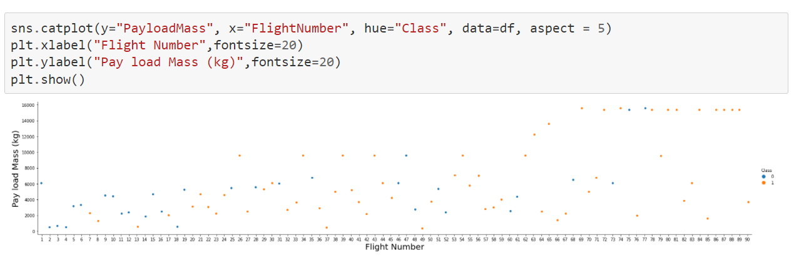
Flight Number vs. Launch Site
From the scatterplot on the right, we see different payload masses have varying success rates, but higher flight numbers generally have more success.
CCAFS LC-40 success rate: 60%.
KSC LC-39A & VAFB SLC 4E success rate: 77%.

Slide 22
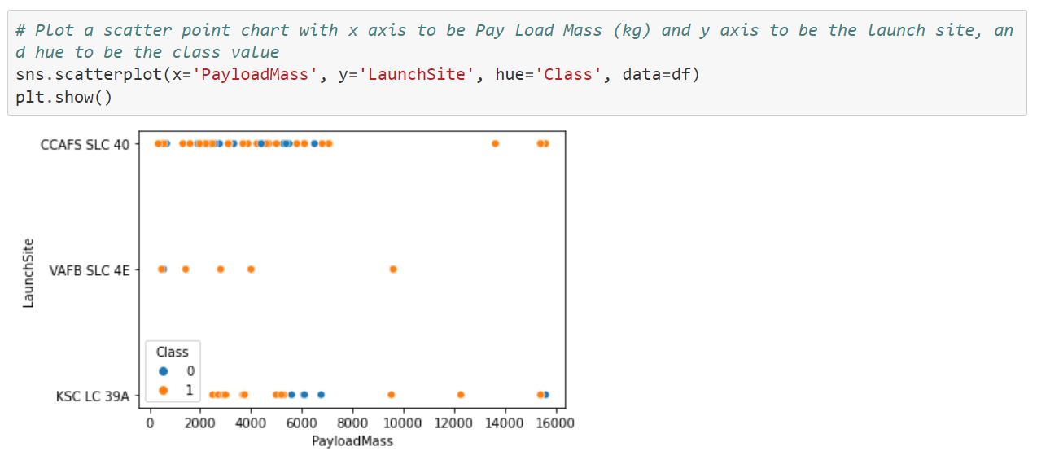
Payload vs. Launch Site
From our next scatterplot, we can see each launch site had varying patterns of success at different payloads.
Most launches came at lower payloads. However, each site experienced differing results no matter the payload mass.

Slide 23
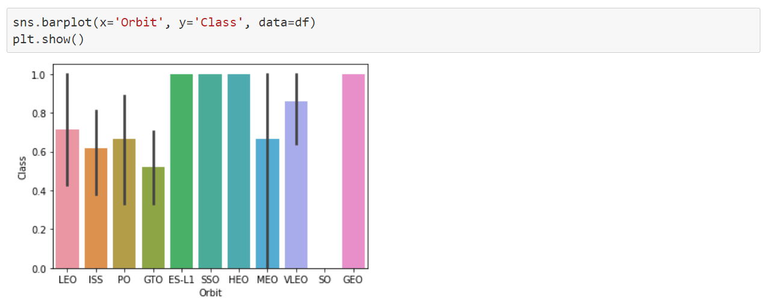
Success Rate vs. Orbit Type
This bar plot illustrates each type of orbit’s launch success rate.
ES-L1, SSO, HEO, and GEO have virtually perfect success rates unlike the other orbit types.
We further want to see what other factors back these orbits.

Slide 24
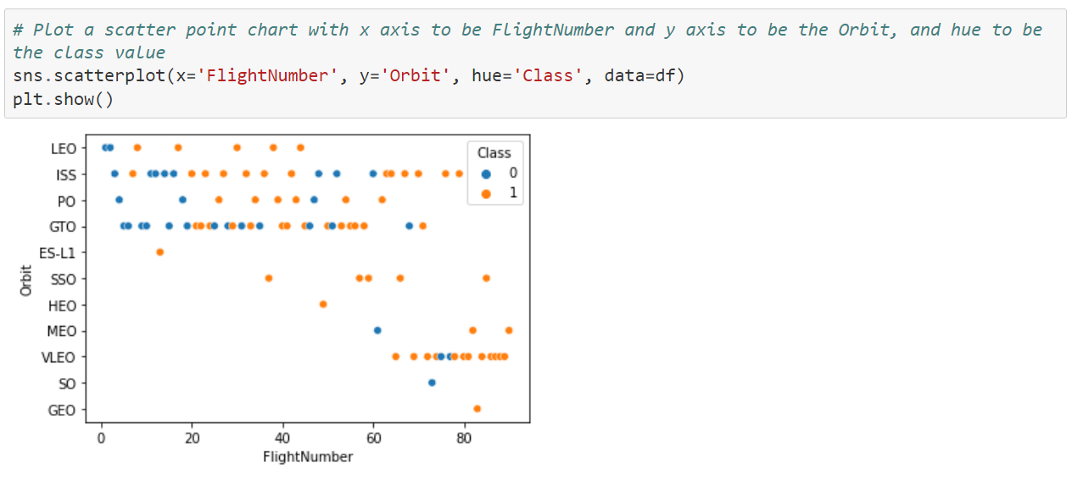
Flight Number vs. Orbit Type
Thus, we make another scatterplot with flight number and orbit type.
We see in general, as flight number increases, the rate of successful launch also increases.
Some orbit types have launched only at high flight numbers, however.

Slide 25
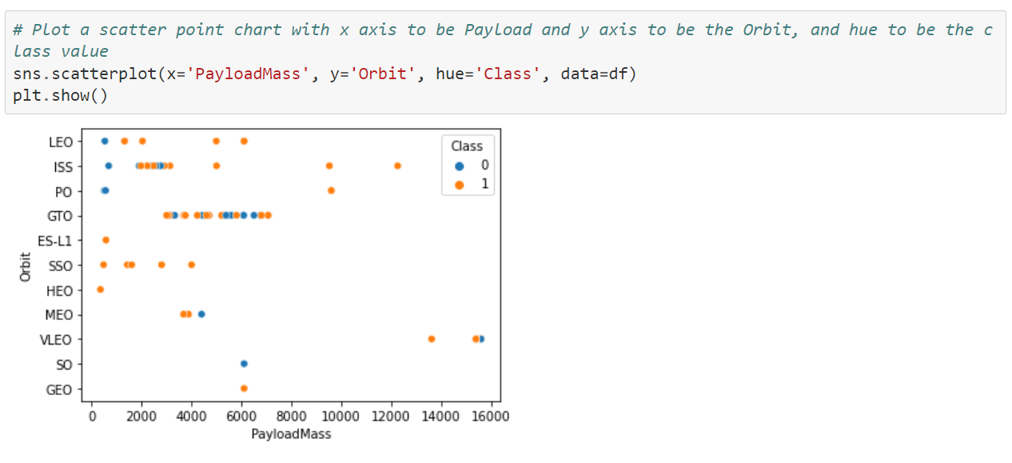
Payload vs. Orbit Type
We next plotted Orbit vs. Payload Mass.
Again, some orbits have more records than others.
In addition, we can see that there isn’t much of a pattern among the different masses.

Slide 26
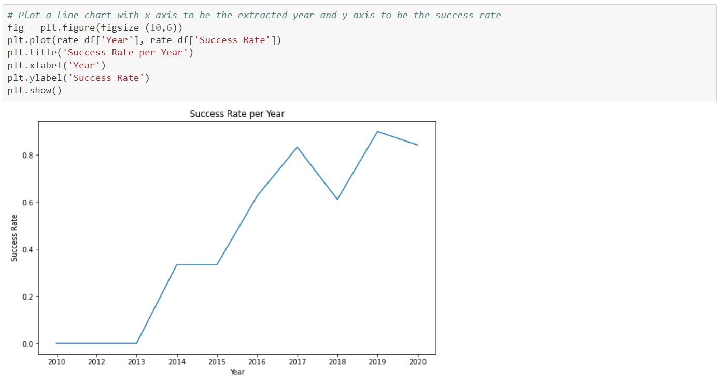
Launch Success Yearly Trend
In order to see how the overall success rate changes overtime, we create the following line plot.
We can see the success rate start to rise in 2013 and increased gradually overtime.
This shows how the development and deployment of rockets improved over the years.

Slide 27
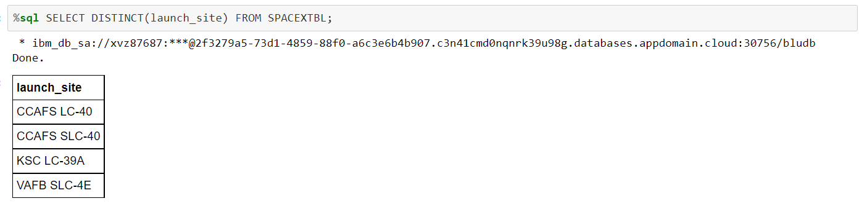
All Launch Site Names
Using SQL we list all the launch site names.
This is more or less a sanity check to ensure we have each launch site name we have analyzed in our data.

Slide 28
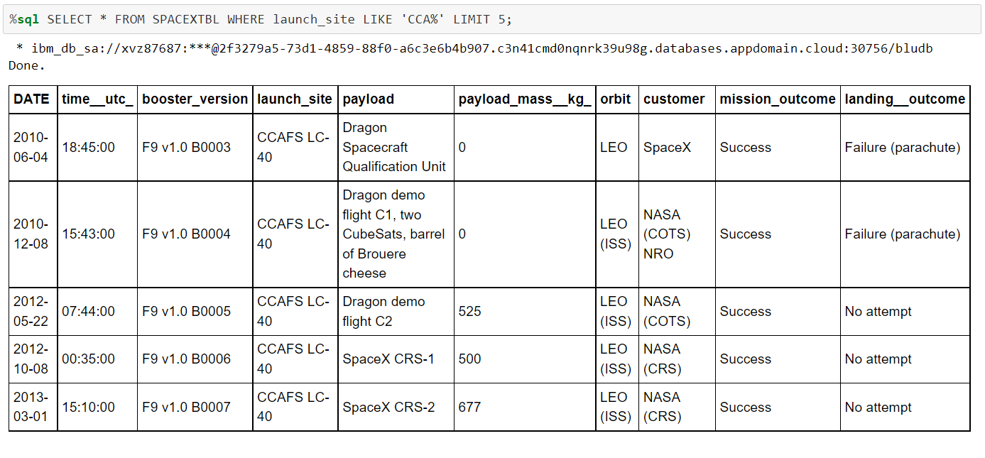
Launch Site Names Begin with 'CCA'
Here we simply list 5 records where launch sites begin with `CCA`.

Slide 29
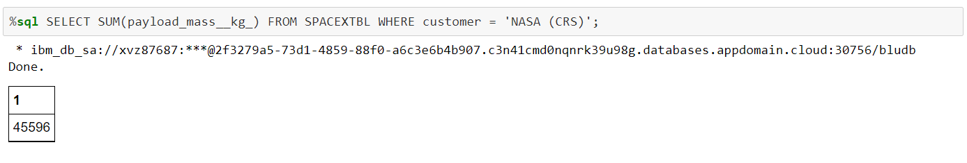
Total Payload Mass
Next, we calculate the total payload carried by boosters from NASA.
If we wanted, we could compare total payload masses used to other boosters.

Slide 30
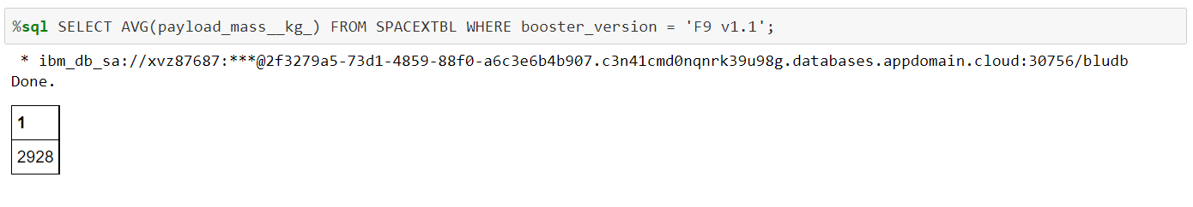
Average Payload Mass by F9 v1.1
We follow up the previous query by calculating the average payload mass carried by booster version F9 v1.1.
We could also juxtapose different payload mass averages with other booster versions.

Slide 31
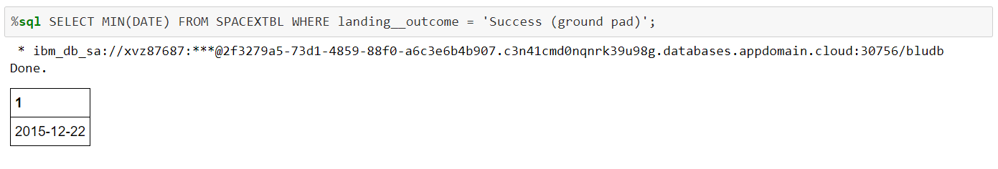
First Successful Ground Landing Date
Below is the date of the first successful ground pad landing.
This is an example of how we could leverage dates to see when and at what rate launches of varying parameters worked successfully.

Slide 32
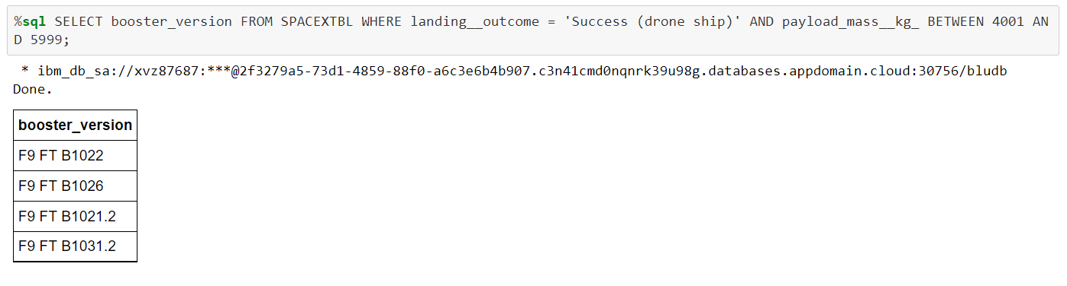
Successful Drone Ship Landing with Payload between 4000 and 6000
Here we list the names of boosters which have successfully landed on drone ship and had payload mass greater than 4000 but less than 6000.
By filtering payload mass, we could see which booster versions were more successful at different values of mass.

Slide 33
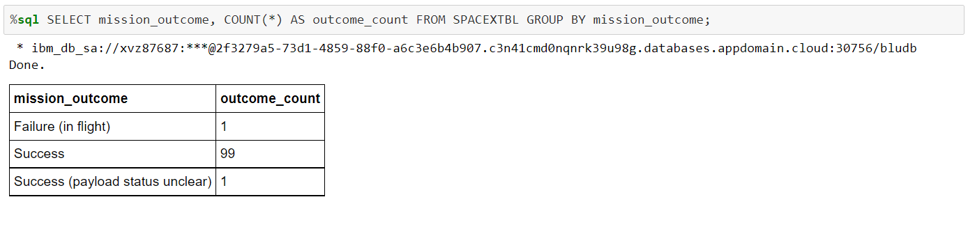
Total Number of Successful and Failure Mission Outcomes
Here, we calculate the total number of successful and failure mission outcomes.
Here we can note how many successful and failed missions there were. Note this is different from landing outcomes.

Slide 34
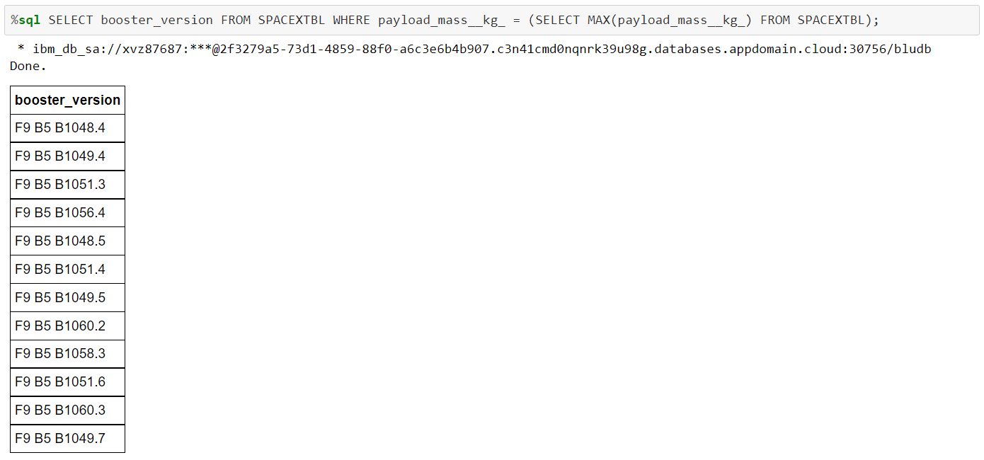
Boosters Carried Maximum Payload
Here we list the names of the booster which have carried the maximum payload mass.
All the booster versions with max payload mass were under Falcon9 B5 rocket versions.

Slide 35
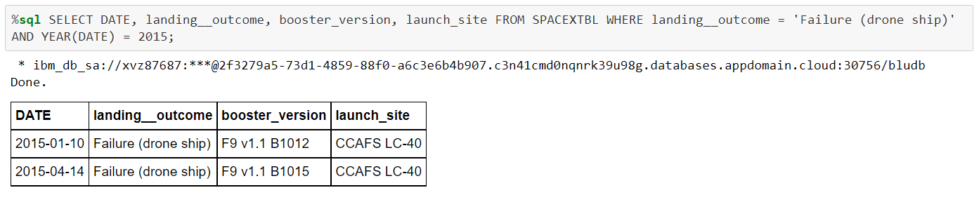
2015 Launch Records
Here we list the failed landing outcomes in drone ship, their booster versions, and launch site names for in year 2015.
Both trials feature identical but not the exact same booster version and come from the same launch site.

Slide 36
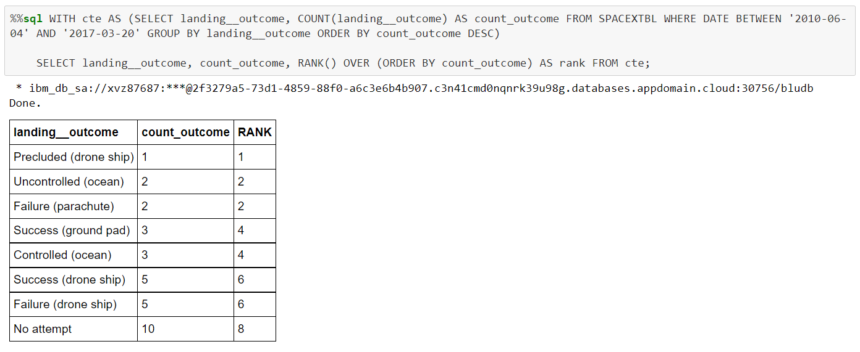
Rank Landing Outcomes Between 2010-06-04 and 2017-03-20
Lastly, we rank the count of landing outcomes (such as Failure (drone ship) or Success (ground pad)) between the date 2010-06-04 and 2017-03-20, in descending order.
With rank representing the count of the outcome per landing outcome, we see each type of landing outcome, whether successful or not, had equal rate of successes and failures for the most part.

Slide 37


Slide 38
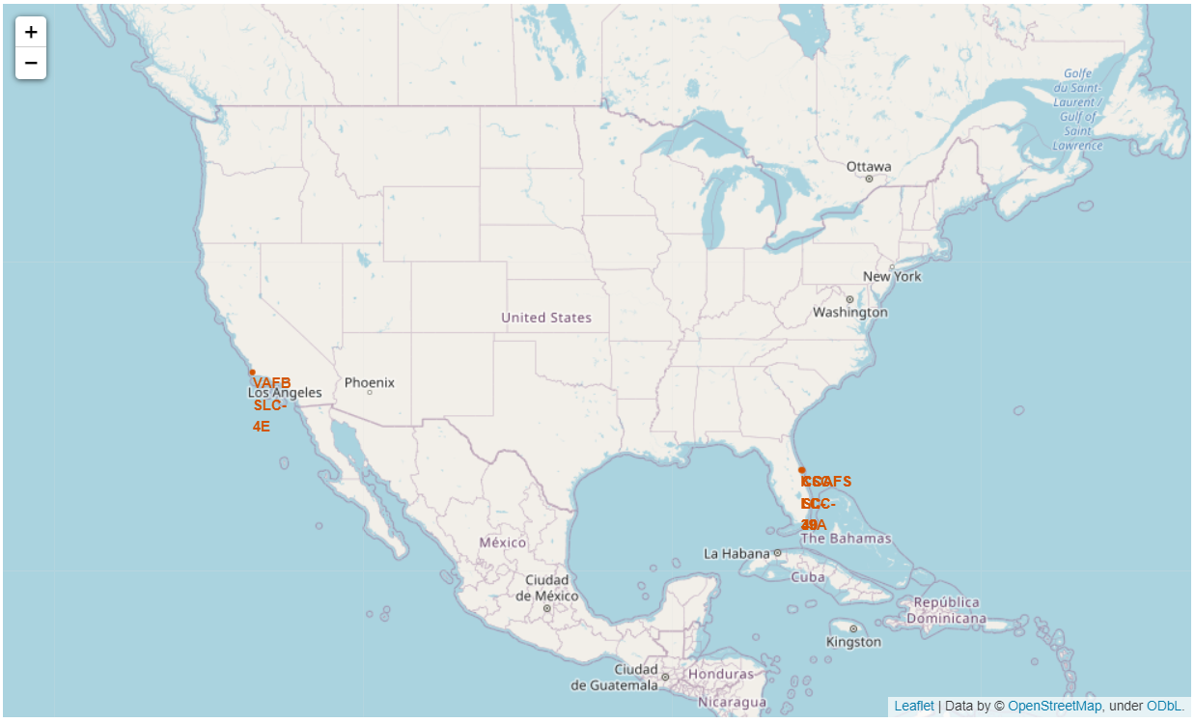
Folium – All Launch Sites Map
Using Folium, we create a map plotting each location of every launch site.
Each launch site illustrated is in either California or Florida, and each of them is along a coastline.
We can investigate further to derive more features from these locations of interest.

Slide 39
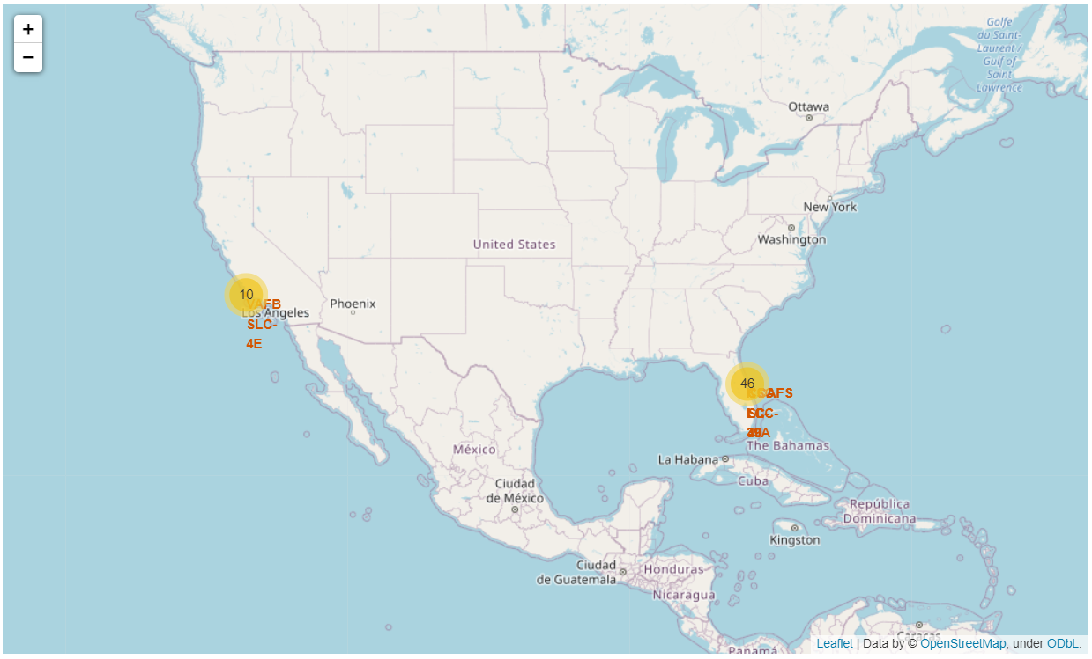
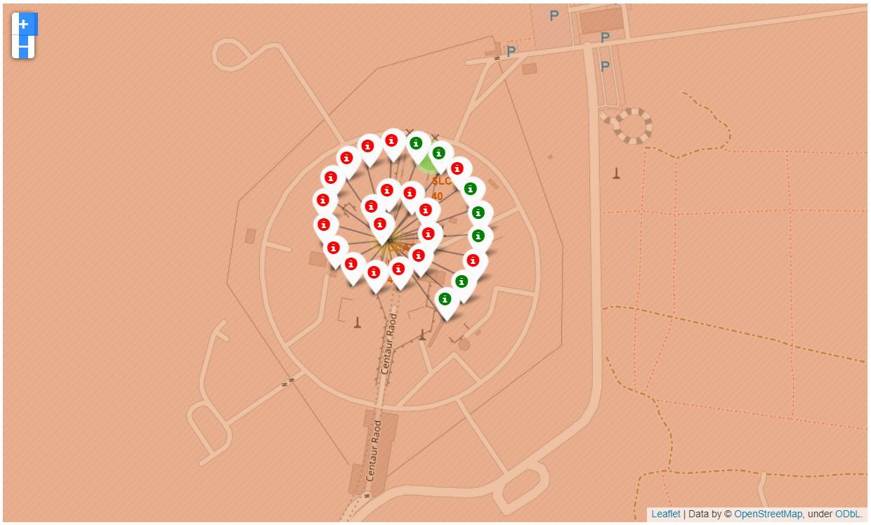
Folium – Launch sites with outcome icons
On the right are the updated maps with icons indicating successful launch outcomes for each rocket.
The red icons indicate a failed launch outcome, while green indicates a successful outcome.
The bottom picture is one example at one site. Other sites have different rates of success.

Slide 40
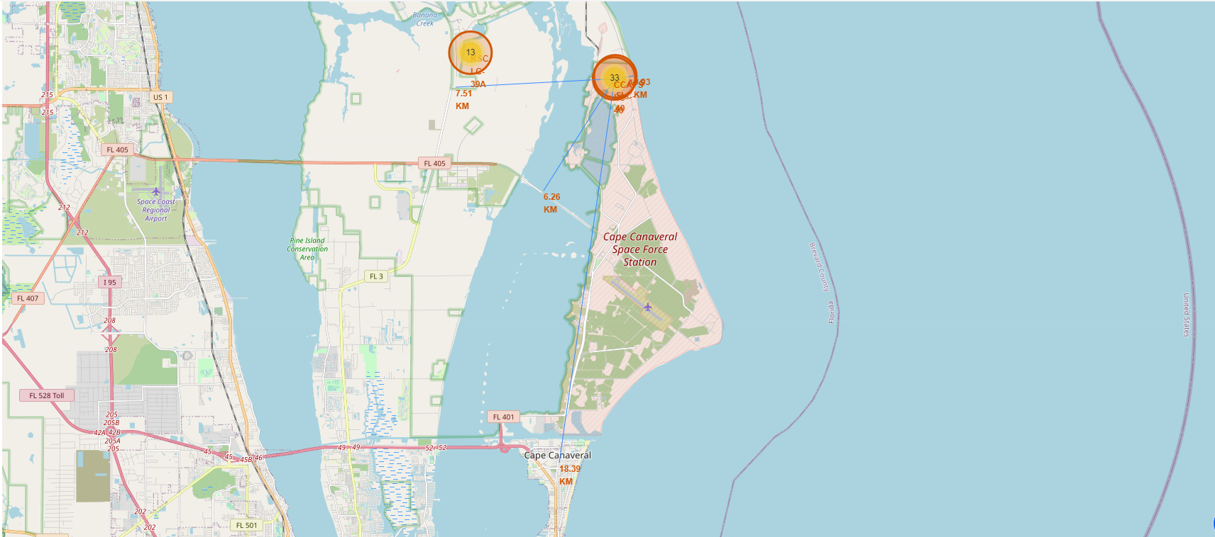
Folium – Distance Marker Map
This updated map features lines with distance markers indicating the nearest highway, railroad, coastline, and city from the launch site.
Each landmark is within 20km of the launch site; therefore, they aren’t very far from the rocket tests happening.
You can interact with the map by accessing this file.

Slide 41


Slide 42
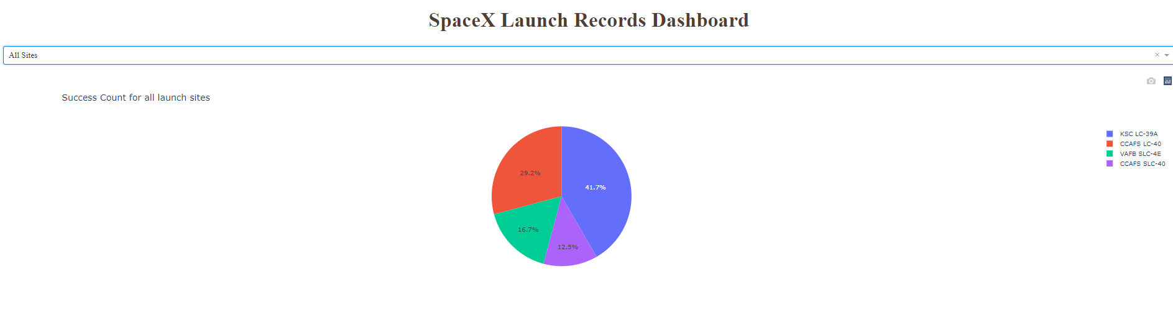
Plotly Dashboard – All Launch Sites
The right figure shows a pie chart depicting how much each site contributed to overall success.
The below chart illustrates success rate vs. payload mass of all launch outcomes.
We can see most successful outcomes come within a range.

Slide 43
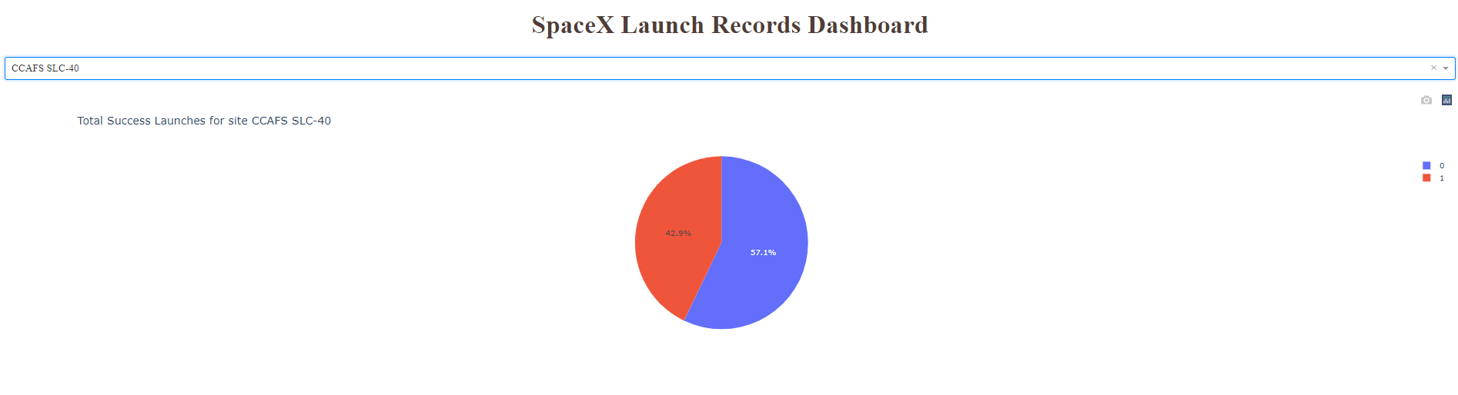
Plotly Dashboard – Highest Launch Success Ratio
CCAFS SLC-40 is the launch site filtered by for the graph to the right.
42.9% of the launch outcomes were successful from this launch site.

Slide 44
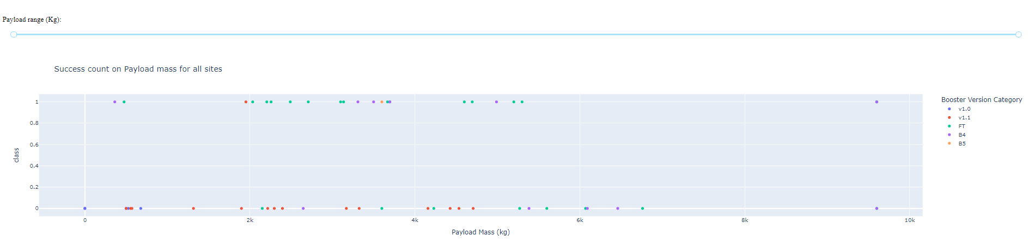
Plotly Dashboard – All Sites Scatterplot
Here is the scatterplot of landing outcome vs. payload mass, colored by each test’s booster version.
We can see most of the successes fall within a range of payload mass. Most of them being the FT booster version.
Having a very high payload mass mostly engendered a failed landing outcome.

Slide 45


Slide 46
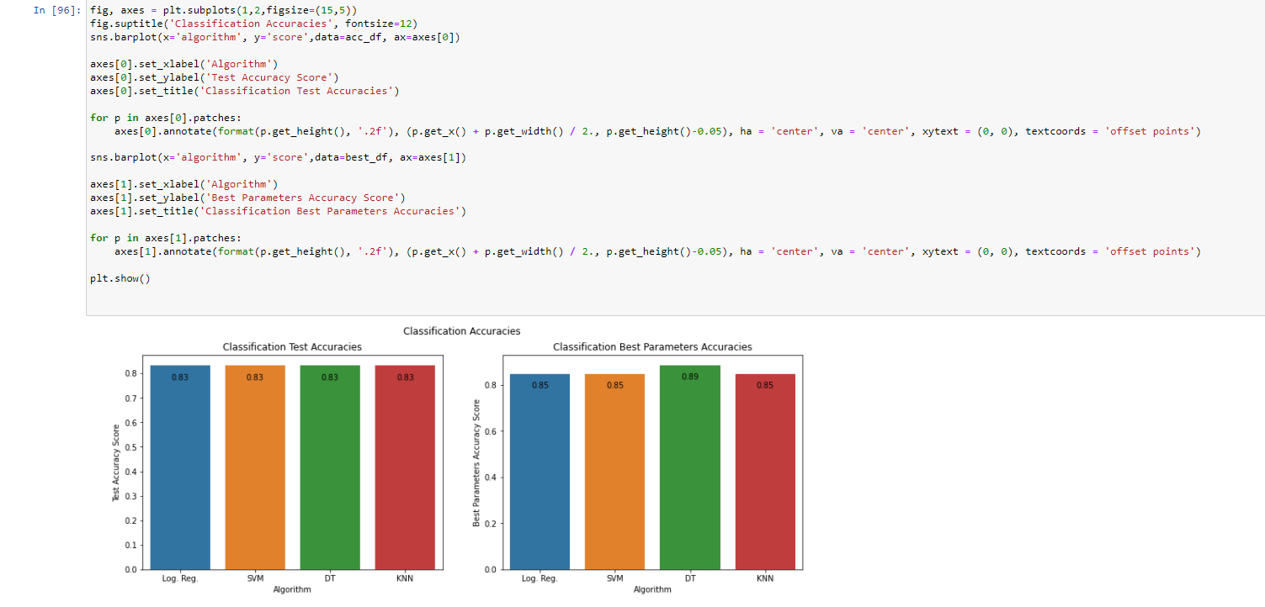
Classification Accuracy
On the right are bar charts depicting classification accuracies for the GridSearchCV best parameters and test sets.
Test set accuracies yielded very similar accuracy scores, while the best parameters’ score elected Decision Tree as the best algorithm.

Slide 47
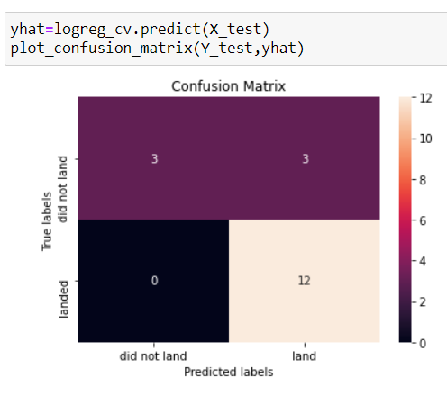
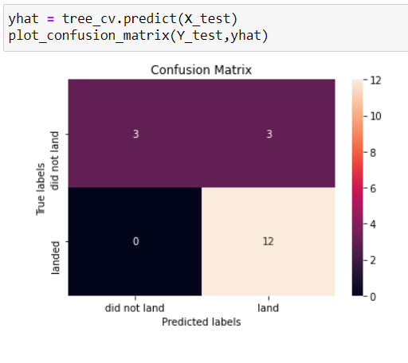
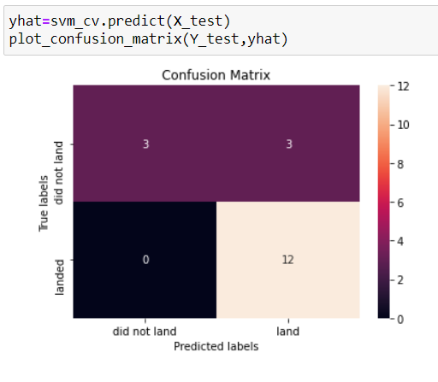
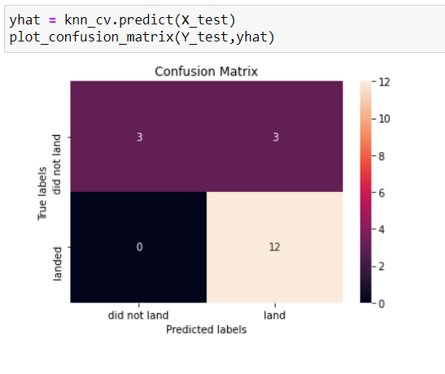
Confusion Matrices
We can see from all resulting confusion matrices, each algorithm had identical results using the test dataset.

Slide 48
Conclusions
Some orbit types had much higher success than others. Therefore, we could emulate our launches to the extent of these orbits in our tests.
Higher flight numbers within a certain range of payload mass had a lot of successful outcomes.
Some orbits had more launches, but at higher flight number generally say more success.
The success rate of launches per year has increased since 2013.
The CCAFS SLC-40 launch site had the highest rate of success.
The classification algorithms perform identically, with possibly a slight edge to the Decision Tree.

Slide 49
Appendix
Link to my GitHub project files: https://github.com/elayer/SpaceXProject/tree/main
Link to SpaceX API information: https://api.spacex.land/graphql/
Help with bar plot creation from: https://github.com/mwaskom/seaborn/issues/1582
Link to Wikipedia page: https://en.wikipedia.org/w/index.php?title=List_of_Falcon_9_and_Falcon_Heavy_launches&oldid=1027686922

Slide 50


